Slide 1
THE W SOURCE™ LAUNCH [Launch Date]
[Location] Chapter
Notes:
Welcome –
a. Please take your seats, food will be out shortly.
Housekeeping items (timeframe, etc.)
I’m going to share more about this group in a moment, but first, I wanted to introduce one of our members, [Member Name], to kick us off.

Slide 2
INTRODUCTIONS
[Name of Member]
[Title] | The W Source™ Member
[Include background/biography here.]
Notes:
Five minute introduction on Member. Member shares why she joined The W Source™.

Slide 3
INTRODUCTIONS
[Chapter Leader Name]
[Location] Group Leader
[Include background/biography here.]
Notes:
Member introduces Chapter Head.

Slide 4
TODAY’S AGENDA
Introduction to The W Source™
Our Story
Who We Are
How Do We Connect and Grow
The W Source™ Reach
The Power of Your Network
Notes:
Today’s agenda will look like this:
With respect for your busy schedules, I promise we will end promptly at [timeframe].
I want to first walk through our story.
I will cover “Who We Are” and allow time for each of us to introduce ourselves.
Next, I will discuss the format for the next group meetings and share when our next meeting is.
Lastly, I will talk a little bit about “Our Larger Vision.”
Finally, we will have a chance to connect on our first business building topic – The Power of Your Network
Networking and kick off the first month.
This is an open dialogue, so please do not hesitate to stop me to ask questions!

Slide 5
OUR STORY
Women work more, and network less than their male counterparts¹
Women statistically have weaker networks than men².
We’re 5x’s more likely to state we have difficulty networking with senior staff
41% of us say that exclusion from informal networks is a barrier to our advancement
Why is the network weaker?
Men are 2x’s more likely to use to use a position of seniority to gain access
Women fear a backlash when acting outside gender stereotypes by being assertive.
1. http://fortune.com/2014/11/12/why-women-should-do-less-and-network-more//
2. https://www.personalboardroom.com/the-network-deficits-of-women/
Notes:
First let’s walk through the story of The W Source™
Academic research supports the thesis that:
Access to a network is a trait of a successful business person
That network affects our chances to be promoted and to grow our businesses.
This is not about gender warfare,
but about a balance in a system that is factually imbalanced.
I want to state some facts and draw a comparison between men and women:
We spend our time working more hours vs. networking when compared to our male counterparts.
We statistically have weaker networks than men.
On top of it all, our perceived assertion when trying to connect with others can be perceived as an unsuitable leadership quality.
My experience is similar. [Share your story as a female in business. Hannah’s story is included below for your reference.]
Hannah’s Story: I started in this industry eight years ago.
I did what I was to told – obtained the necessary licenses,
Got my Certified Financial Planning (CFP) Designation which is the gold standard in our industry
Because I wanted to work with women, I got the Certified Divorce Financial Analyst (CDFA™) designation
I am a partner at AmeriFlex® and I helped it grow to $1 Billion AUM
But like many of you in this room, I want to continue to grow my client base, so I sought a way to connect with other women.
And I did so through The W Source™. The W Source™ gave me a formal network that helped me to serve my clients better and grow my business.

Slide 6
THE W SOURCE™ MISSION
The W Source™ fosters a network of female professionals and business owners to share ideas, knowledge, and opportunities.
We facilitate a dynamic environment for our members to collaborate through connections within the local community.
Our members represent a diverse business group of various specialties, goods, and professional services.
Notes:
Our mission statement is:
The W Source™ fosters a network of female professionals and business owners to
Share ideas,
Knowledge,
And Opportunities
We facilitate a dynamic environment for our members to
Collaborate through connections
Within the local community
Our members represent a diverse business group of
Various specialties
Goods
And professional services

Slide 7
WHO WE ARE
Common Traits
Industries We Represent
Dedicated service professionals
Committed
Engaged
Passionate about growth
Industries We Represent:
Banking/Finance
Accounting
Real Estate
Insurance
Law
Miscellaneous
Notes:
In building this group, we sought you out because you each are dedicated service professionals who were looking for networking opportunities locally.
You each are committed to your
Careers and your families
You are engaged with your community
Whether that be that you are recognized as the top in your field
Or that you give back in a non-profit capacity
Finally, you are passionate about growth
Not only about your own career but also about female-centric networking.
I would now like to take the time to go around the room and introduce yourselves to the group.
Could you say your name, what you do, your firm, and why you decided to be a part of The W Source™?
We’ll start over to our right…

Slide 8
HOW DO WE CONNECT & GROW
90-minute Meeting
Announcements
Member Showcase
Endorsements
Business building tools & discussion
Guest speakers when appropriate
“One-on-One’s”
In between monthly meetings
Notes:
Now that we’ve had the chance to introduce ourselves, I want to walk through what it looks like going forward.
You’ve indicated that the best day seems to be _________________ [INSERT DATE OF FUTURE MEETING]
At _______ [insert location]
The Group Meetings are designed to specifically support each of our growth. Our goal is support each other in business and the rest will come on it’s own.
Let’s walk through the next group meeting
We’ll always start with introductions and announcements with time to share anything with the group.
Then we’ll have what we’re calling Announcements which is an opportunity to share
an announcement,
or an opportunity,
and to ask for help from other members.
Next is the time for Member Endorsements. I will introduce how that works for the next two meetings in a moment. Conceptually, these are:
opportunities to thank a member for referring a potential client,
or for taking the time to help them/their clients with a personal/business matter.
We will have opportunities to have Guest speakers who can share relevant business building tools and thoughts such as “how to optimize your LinkedIn for Networking.”
Finally, we’ll assign our “One-on-Ones”
“One-on-Ones” will begin next month
These are designed to build trust and rapport amongst members. You will coordinate with your assigned pair on your own schedule, and it is your responsibility to connect before the next monthly meeting. This can consist of meeting for coffee, going for a walk, or happy hour.
Like I said, we’ll start these next month and we can review them then.

Slide 9
HOW DO WE CONNECT AND GROW
Once we understand the services our group provides, we transact referrals and then share those successes within the group!
Notes:
Once we have the opportunity to hear from our members during the first three meetings and continually over the coming year,
we will educate the group on the services our network provides, and transact referrals.
We are here to grow our networks, so this portion of the connection is key.
In a perfect world, when one of my clients has a need that is outside my wheelhouse,
I will turn to this group for that service.
And I am absolutely comfortable that each of you will respond quickly,
and where possible, collaborate to better that client.
I am so excited to see how each of your businesses are going to grow immensely because of your membership in this group.
(Short explanation of circle image) You’ll see this image a lot—we like simple explanations of why we’re all here.
In a moment, you will all go through a worksheet that will help explain to the group what you do that is unique.
You will have a chance to share with the group what you do during your member spotlight and over time, the group will become your voicebox in the community.
In a perfect world, when our clients have a need outside of our expertise, that we turn to each other in the group for those resources.
I’m comfortable each and every one of you will respond quickly and will take great care of that client.
I’m so excited to see how your businesses will grow because of this group.

Slide 10
THE W SOURCE™ REACH
Chapters Opening Across the Nation
Chapter-to-Chapter Networking
Know that you have a trusted and vetted professional network
More to Come!
Notes:
The W Source™ reach: As we speak, other members are connecting with their local chapters of The W Source™. Currently, there are local chapters open or scheduled to open across the nation.
As we grow, we can begin to connect between chapters.
Know that you’re part of this unique group and there is more to come!

Slide 11
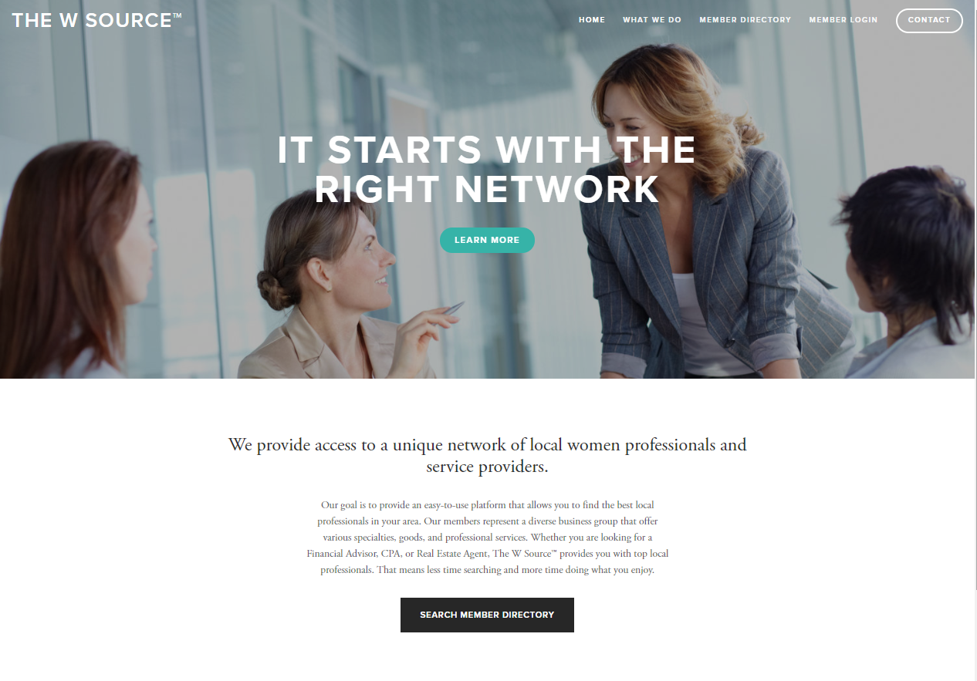
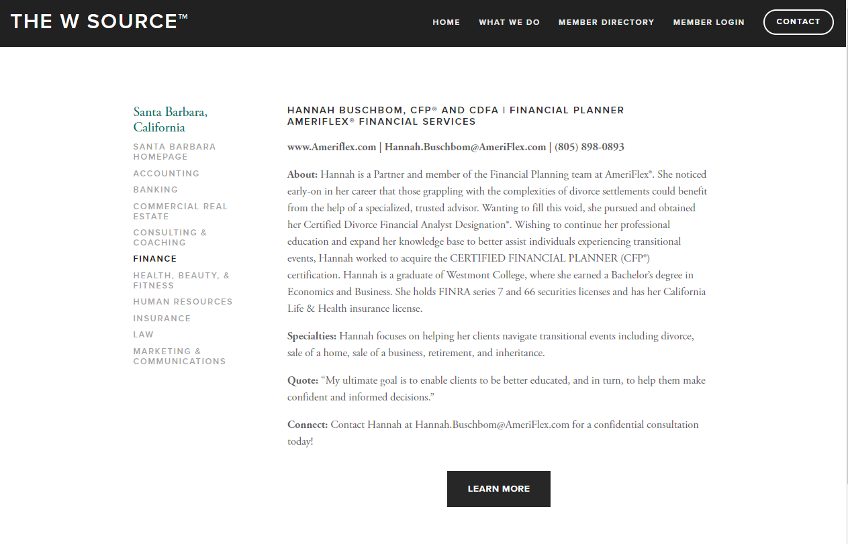
THE W SOURCE™ UNVEILING!
Click here to view website.
Notes:
I know some of you have seen the website and others have not, so what I’d like to do now is briefly walk you through the website.
Here, we are starting on our homepage. As you can see here, our focus for the site is simplicity and professionalism—we want it to be straight forward, user-friendly, and nothing overly-complicated. This part of the website is all consumer-facing, meaning that anyone will be able to access this part of the website. There is a part of the website that I will show you in a moment that is password protected and provided solely for you—the members.
One of the parts of the website that I would like to highlight today is the Member Directory. Now, again, this is part of the consumer-facing part of the website. So, say I’m someone from Santa Barbara and I’m looking for a female financial advisor. We’ll go here to the Member Directory in the upper right-hand corner, and I’ll click here on California, then on Santa Barbara, and this will bring us to the Santa Barbara Group. I would then click here on the Finance category and it would take me to the vetted professional, the financial advisor in Santa Barbara—in this case, Hannah Buschbom. This page gives a little bit of information about Hannah and how to connect with her. If I click on the “Learn More” button, this will take me to her website. The idea is that a consumer should be able to go to a professional’s page on The W Source™ website and be taken to her company website—at the end of the day, where her time and energy is focused.
Now, the other part of the website that I would like to highlight is the Member Login section of the website. This part of the website is password protected, and we will provide you with the password in a follow-up email if you do not already have it.
There are three options here:
I am a new member: This is where a professional has expressed interest in joining and will fill out a Member Application. Here, she will provide some information such as her business, the industry she works in, and what her goals are in joining The W Source™.
I am a current Member: This is where we are today. Most of you in this room have filled out your New Member Application and are ready to complete the onboarding process which I will outline in just a moment.
I am a Chapter Head: This is for Chapter Heads, such as [Chapter Head name].
Now, I’ll go ahead and click on the “I am a Current Member” link. As mentioned, this is where we are today—you have expressed interest in joining the group, your application has been approved, and you are ready to submit your payment and biography. Now on this page, you’ll see three steps.
Step 1 – Review Benefits and Pricing which you have already gone over with [Chapter Head name].
Step 2 – Submit Payment. This should take no more than five minutes and you will just need your credit card information and some basic information such as your name and email.
Step 3 – Submit Biography. Once you have submitted your payment, you can then submit your biography which will be used to create your public profile on The W Source™ website (Hannah Buschbom being an example earlier).
That was a brief overview of the website, but I just want to pause to see if you had any questions so far.
Now if we go back to the slides here… (Continue onto next slide.)

Slide 12
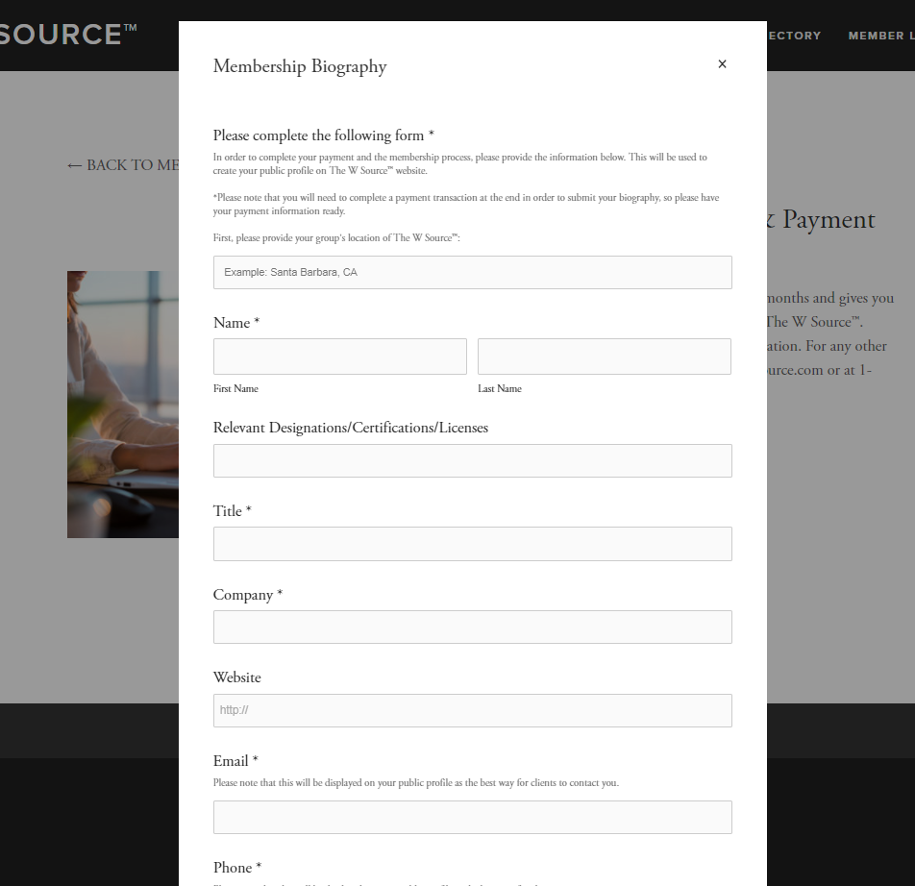
NEXT STEPS
Submit:
1. Member Application
2. Payment
3. Biography
Notes:
As I mentioned, we will need a few pieces of information to complete your membership in the group today. In front of you are packets that contain copies of the following (if you haven’t completed them already):
1. Member Application
2. Payment Authorization
3. Biography Template
Staff at The W Source™ will follow-up with each of you in the coming week to help you submit your Member Dues and Member Biography for hosting on The W Source™ website. They will provide directions in a follow-up email after this meeting. As soon as you submit your Application and Dues you will receive a Welcome Packet that will walk you through the creation of your Value Proposition – a vitally important piece of your participation in our group. Without this piece you will be missing out on a very important opportunity to tell your story to the group – and help us send referrals to you!
If you have any questions, please always feel free to call the corporate office at 1-833-W-SOURCE or email at Info@thewsource.com to set up a time when they can walk you through the onboarding process, step by step. Thank you!

Slide 13
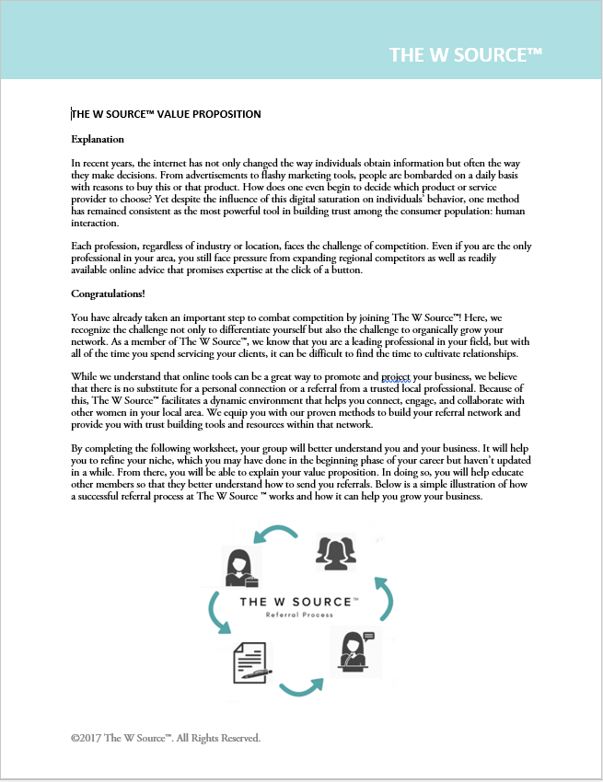
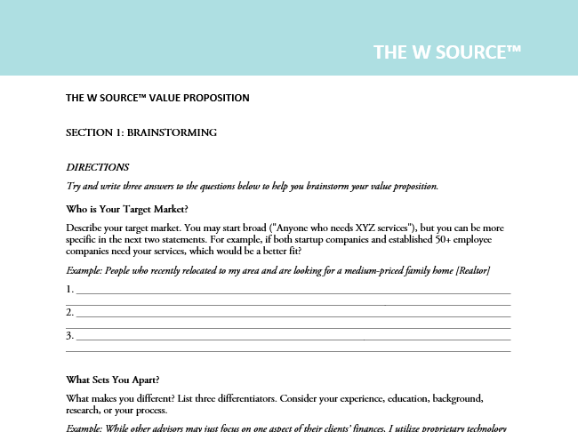
THE W SOURCE™ VALUE PROPOSITION
Notes:
In recent years, the internet has not only changed the way individuals obtain information but often the way they make decisions. From advertisements to flashy marketing tools, people are bombarded on a daily basis with reasons to buy this or that product. So how does one even begin to decide which product or service provider to choose? Yet despite the influence of this digital saturation on individuals’ behavior, one method has remained consistent as the most powerful tool in building trust among the consumer population: human interaction.
Each profession, regardless of industry or location, faces the challenge of competition. Even if you are the only professional in your area, you still face pressure from expanding regional competitors as well as readily available online advice that promises expertise at the click of a button.
As a member of The W Source™, you have already taken an important step to combat competition! Here, we recognize the challenge not only to differentiate yourself but also the challenge to organically grow your network. As a member of The W Source™, we know that you are a leading professional in your field, but with all of the time you spend servicing your clients, it can be difficult to find the time to cultivate relationships.
While we understand that online tools can be a great way to promote and project your business, we believe that there is no substitute for a personal connection or a referral from a trusted local professional. Because of this, The W Source™ facilitates a dynamic environment that helps you connect, engage, and collaborate with other women in your local area. We equip you with our proven methods to build your referral network and provide you with trust building tools and resources within that network.
By completing the following worksheet, your group will better understand you and your business. It will help you to refine your niche, which you may have done in the beginning phase of your career but haven’t updated in a while. From there, you will be able to explain your value proposition. In doing so, you will help educate other members so that they better understand how to send you referrals.

Slide 14
THE W SOURCE™ VALUE PROPOSITION
Who is Your Target Market?
What Sets You Apart?
What Problem Do You Solve?
How Do You Solve the Problem?
What Drives You In Your Work?
Put It All Together
Notes:
(Go through the worksheet, section by section, and pause for breaks to allow members to fill in the sections.)

Slide 15
THANK YOU!
Please feel free to reach out to us with any questions at:
1-833-W-SOURCE
Info@TheWSource.com
www.TheWSource.com

